Slide 1
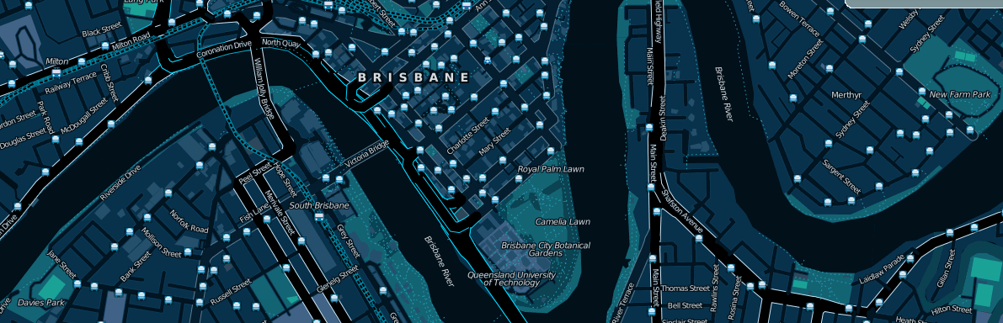
OpenStreetMap and other openly licensed geodata

Slide 2

What is OpenStreetMap?
Geographic data
  For driving, riding, walking, boating, skiing, hiking, anything
Free
  Currently CC-BY-SA, moving to ODBL
Wiki-like editing
http://www.osm.org

Slide 3
Why not just use Google Maps?
or WhereIs/Yahoo/Bing Maps?
or whatever is on your GPS/IPhone?

Slide 4


Updated rapidly
Google
OpenStreetMap

Slide 5
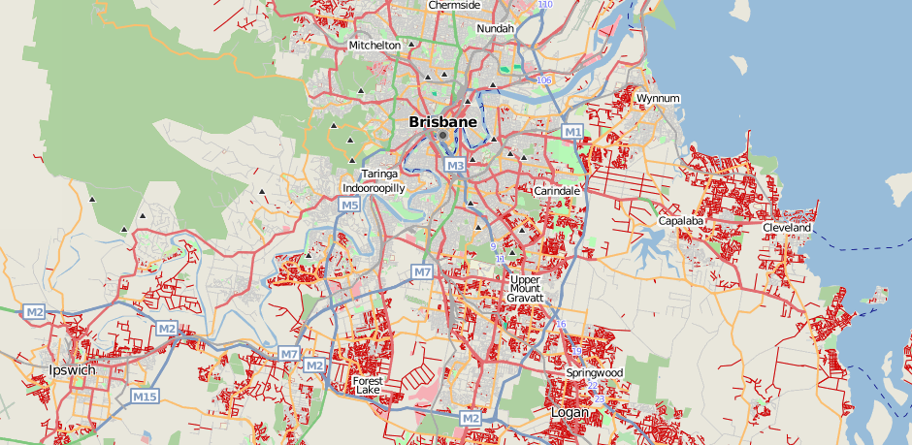
But, coverage can be poor

Slide 6



Not just for cars

Slide 7

Data freely available (and editable)

Slide 8

Raw traces are available too

Slide 9




Free data means you can do more neat stuff

Slide 10
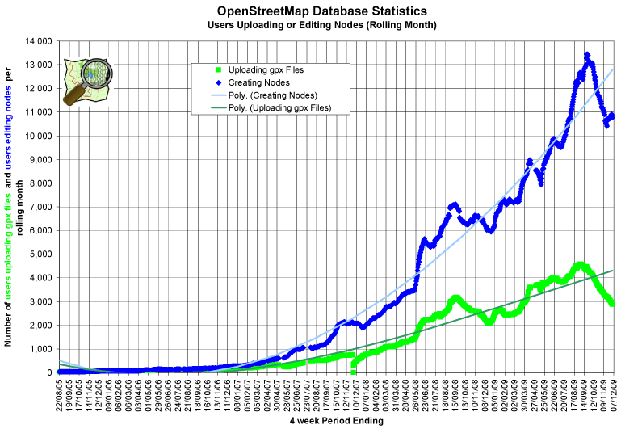
Lots of Mappers

Slide 11
Worldwide activity
OSM 2008: A Year of Edits

Slide 12
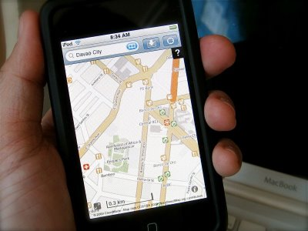
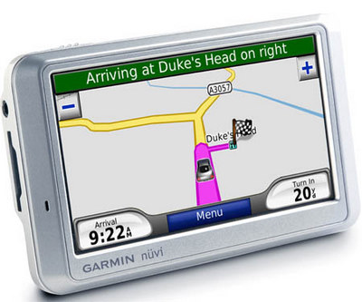
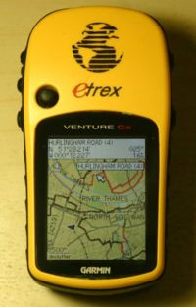
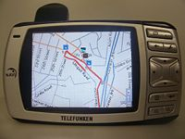
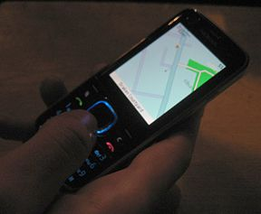
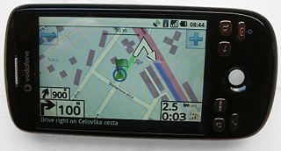
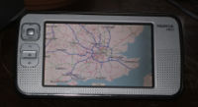
Available on many devices
Garmin PNDs
OffMaps on IPhone
Garmin GPSs
Gosmore on Windows Mobile
AndNav2 on Android
GPSMid on J2ME
MaemoMapper on Nokia Maemo

Slide 13
So, how do you map?

Slide 14

(Option 1) Trace aerial imagery

Slide 15


(Option 2) Go outside
Take notes, →
record your trip (optional),
and update the map from your notes at home

Slide 16

(Option 3) Be social
Brisbane mapping events occur monthly
  Alternate between mapping parties and social meetups
Next event: OSM Christmas Meetup
  7pm Wednesday 16th December at Sawadee Kaa, West End
What is a mapping party?
  A group of people get together to map a large area in a single day
  Example: Macleay Island in November 2009

Slide 17

Data representation
Geographic information is represented as
  Nodes
  Ways
    Ordered collections of nodes
    Closed ways can be areas
  Relations
    Ordered collections of ways and nodes
All can be tagged with any key/value pairs

Slide 18


No formal key/value ontology
Let freedom flourish!
Common tagging is encouraged
  Map Features wiki
  Editor presets
  Renderers
  OSMDoc
  Tagwatch

Slide 19
Other openly licensed geodata

Slide 20
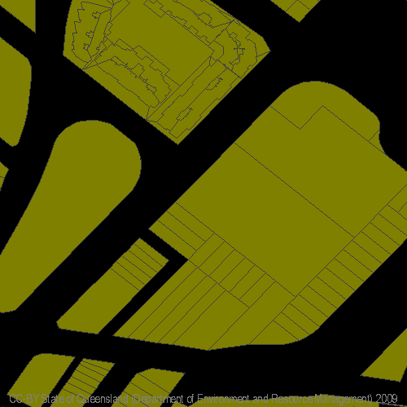
data.australia.gov.au
Queensland property boundaries
Local government boundaries
Wetlands Mapping

Slide 21
NearMap
NearMap provide very high resolution Aerial Imagery under CC-BY-SA-NC
'Traced' derived data can be licensed under CC-BY-SA (i.e: can be commercial)
  Suitable for inclusion in OpenStreetMap
Might be very useful for image processing research

Slide 22
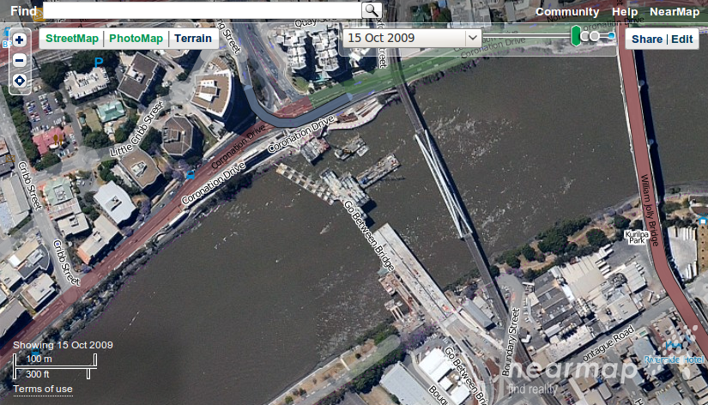
Imagery is updated monthly!

Slide 23
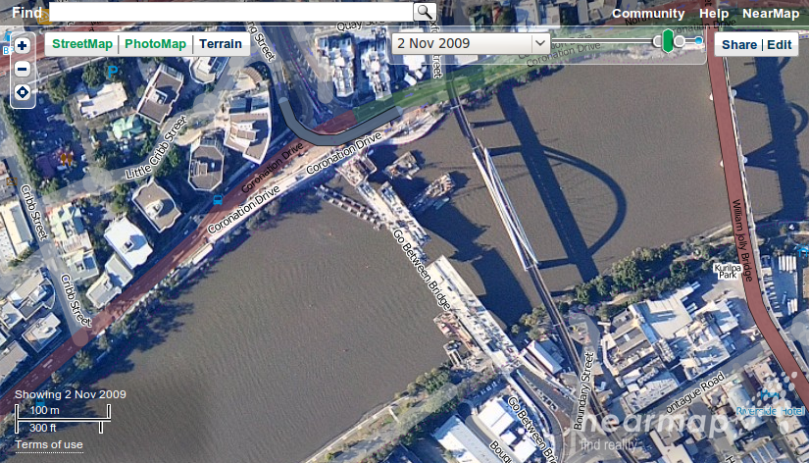
Imagery is updated monthly!

Slide 24
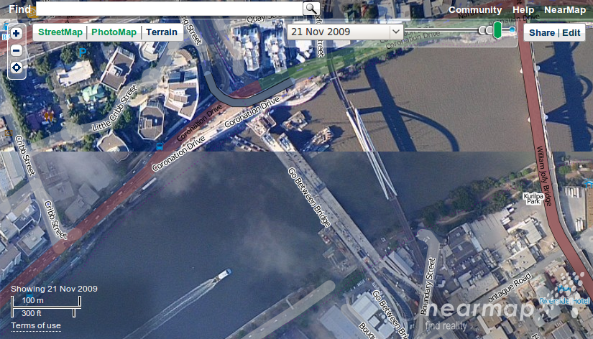
Imagery is updated monthly!

Slide 25
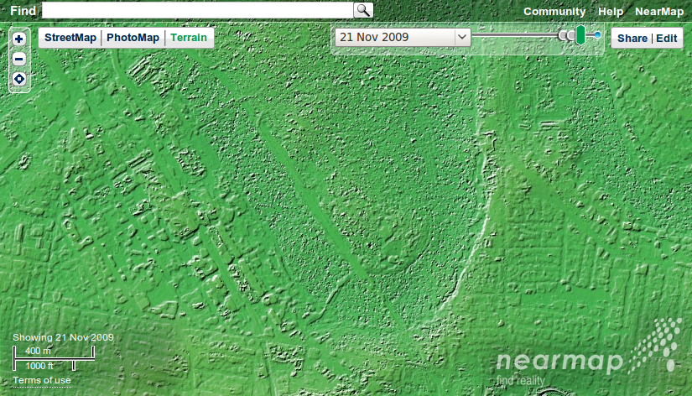
Terrain elevation is also collected

Slide 26
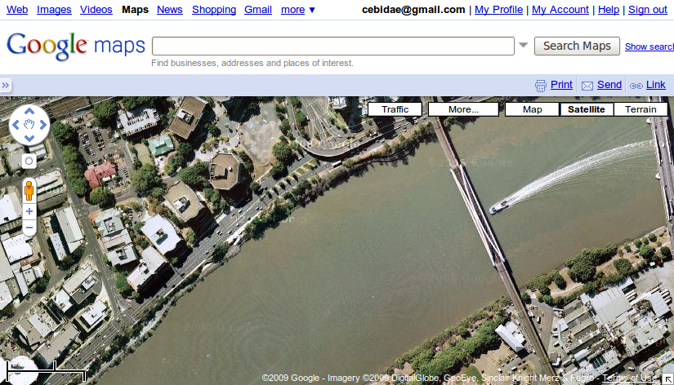
And Google Satellite?

Slide 27
So what use is all this to SAIVT?

Slide 28
Audio?
Not a lot
We could take open-source navigation software to (relatively) quickly make a functional in-car speech-based navigation system.
OSM name tagging could also be used to narrow the search space for such an application.

Slide 29
Video?
More likely
Many projects could be easily be conducted using NearMap imagery and OSM/Government geodata:
HV power-line detection
Construction/building detection
Automatic mapping updates from aerial imagery
Land use management

Slide 30

Questions/Suggestions?
Thanks for listening.

